Slide 1
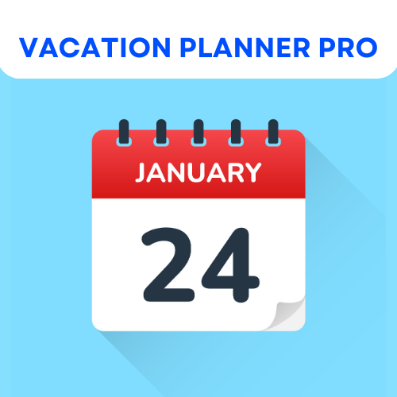
Spring 2024
Software Engineering Practices
Team Retrospective

Slide 2
What worked best during this last Sprint?
Leadership
Bi-weekly meetings
One-on-one sessions
During this last sprint, what worked best was our leadership and collaborative efforts. Particularly, our bi-weekly team meetings became more productive, ensuring our preparedness for the next class, maintaining momentum, and focusing on incorporating stakeholder feedback.

Slide 3
What didn’t work during this last Sprint?
Task delegation
Time management
Ambitious Goals
These insights highlight the importance of building confidence among team members and establishing a transparent and inclusive task delegation process.

Slide 4
What would you like to keep the same if you were to do another project with the same team?
Discord
Meeting frequency
Team Roles
“Have the same people in the same roles. Everyone worked well where they were.”

Slide 5
What would you do differently if you were to do another project with the same team?
Code comments
Peer review system
Professor assistance
While our communication is steadily improving, we would aim to enhance involvement with daily check-ins, seeking professor assistance, and suggesting project-relevant lecture topics.

Slide 6








What kind of resources did we require?
Open Liberty
GitHub
Docker
React
LinuxONE
PostgreSQL
CORS
Node.js
APIs
Discord
Trello

Slide 7
What resources did we not have which may have helped our progress?
Time
AWS
More training
In our project, we effectively made use of all necessary resources, but additional time was a major resource that we lacked.

Slide 8
What role did everyone play?
How well did these roles work out?
Scrum Master
Status Reporters
Back-end developers
Front-end developers
Database architects
Testers
“Cheyenne was elected scrum master, based on the last sprint, it was a consensus that she had the required soft skills to keep the team on track. Oscar, Cheyenne, Catherine, Gabriella, Adam, and Ruth presented status reports. Catherine, Oscar, and John presented modules for code review, with Ruth as the scribe. Overall, everyone prepared their materials appropriately and did a good job.”

Slide 9
In the future, what type of task delegation do you think would be successful?
Limited volunteering
List-based system
“Buddy” system
To enhance accountability and encourage learning, a "buddy" system, where pairs switch tasks each Sprint, could be implemented.

Slide 10
Do you feel that we met the goal of the project?
Yes!
“Yes, I think our site is great and given the time we had we accomplished a lot.”
“Yes, the application allows a user to schedule vacation with the appropriate parameters given, and it includes other important features such as a sign-up page, log-in page, calendar landing page, and a logout button. We did have ambitious goals and didn't met all of them, but the results are solid.”
Throughout each Sprint, we enhanced communication following Agile methodologies, becoming more comfortable addressing disagreement and staying focused on project goals.

Slide 11


What has been your favorite topic(s) to learn about from this course/project?
Databases
Back-end
Front-end
Design Thinking
Dev Ops
React
Agile Development
Server architecture
APIs
GitHub

Slide 12
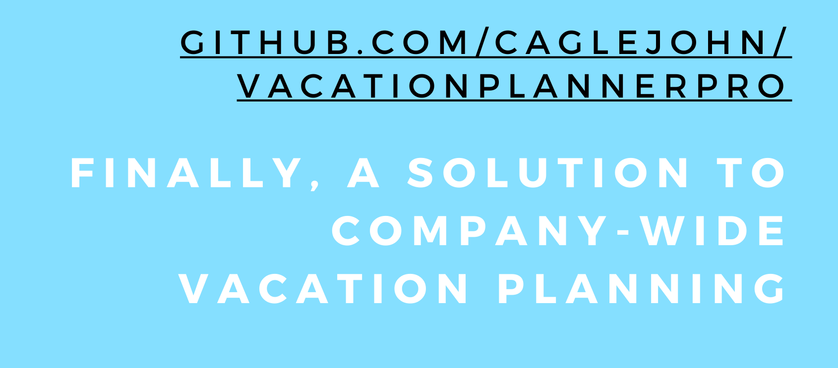
THANK YOU
Professor Thomason & Professor Sheehan
Everyone at IBM ~ Alex, Anu, Paul, & Rumana
Guest Speakers ~ John Rofrano & Trevor Ward
SUNY Ulster
Vacation Planner Pro ~

